Slide 1
Roy Williams Foundation
Veterans Services (VA)

Slide 2
Introduction
Leisl Hammond, Major (R) USA, MBA
Chairwoman
Roy Williams Foundation
Director/VSO
Veterans Service Office
Retired Army – Served 1996 to 2019
Medical Operations Officer – Strategic/Operational Planning
Born and Raised in Salida

Slide 3
Roy Williams Foundation Estabished 2021

Slide 4
Roy Williams Foundation
Roy Williams lived in Poncha Springs and served as a Sheriff’s Deputy. Prior to his arrival in Chaffee County, Roy was a Soldier in the United States Army. He completed combat tours in Iraq and Afghanistan. In January 2018, he began his career in law enforcement with the Chaffee County Sheriff’s Office serving honorably until his death on 5 November 2019. According to the Sheriff’s Office, he was well respected by both his peers and his command.
Notes:
Mission of VA: To fulfill President Lincoln’s promise,
1. It was March 4, 1865, a time of great uneasiness. In just over one month, the war would end and the president would be assassinated.
“With malice toward none, with charity for all, with firmness in the right as God gives us to see the right, let us strive on to finish the work we are in, to bind up the nation’s wounds, to care for him who shall have borne the battle and for his widow, and his orphan, to do all which may achieve and cherish a just and lasting peace among ourselves and with all nations.”
“To care for him who shall have borne the battle, and for his widow, and his orphan” by serving and honoring the men and women who are America’s Veterans. (www.va.gov)
2. VA budget= $266 Bn in FY22. In 2022 there are approximately 20M Veterans which should translate to each Veteran getting the benefit of $13,000 per Veteran PER YEAR.
3. But only 9m Veterans of 20 M are in the VHA system – 45% taking advantage. NEED TO GET THE WORD OUT – MARKETING
4. The Veterans Health Administration is the largest integrated health care system in the United States providing care at 1,298 health care facilities to over 9 million Veterans. We have 3 major facilities in CO – Aurora, Co Spgs and Grand Junction. Chaffee is in CO East VAMC with Aurora and Co Spgs. The VA overall is the 2nd largest Federal Department behind the DoD. The VA employs 412, 892 people in the United States plus contractors.
5. @ 604 programs: VHA – @ 484 programs + VBA over 100 payment programs + NCA over 20 programs and 4 cemeteries in CO
6. Chaffee County has 20,074 residents and is home to 1,820 VA registered Veterans per the GDX report FY2021. 9% are Veterans.
7. Yes – Leisl Hammond, VSO, Salida
8. Yes – See Leisl Hammond, VSO, Salida
9. CO is 7% below average on using benefits / Veteran and Chaffee is 37% below average on using benefits / Veteran of CO counties. GET THE WORD OUT TO VETS!

Slide 5
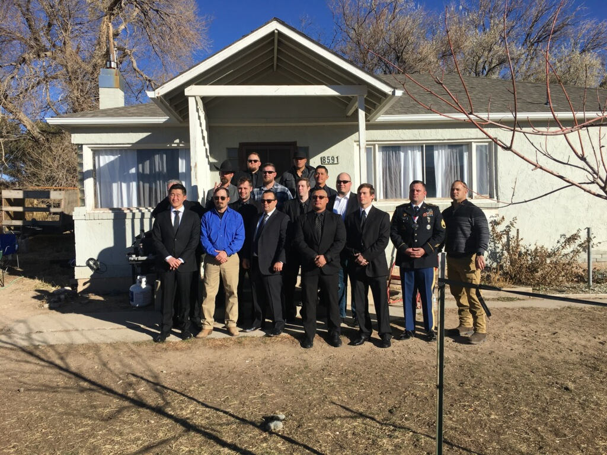
Roy Williams Foundation
Notes:
Mission of VA: To fulfill President Lincoln’s promise,
1. It was March 4, 1865, a time of great uneasiness. In just over one month, the war would end and the president would be assassinated.
“With malice toward none, with charity for all, with firmness in the right as God gives us to see the right, let us strive on to finish the work we are in, to bind up the nation’s wounds, to care for him who shall have borne the battle and for his widow, and his orphan, to do all which may achieve and cherish a just and lasting peace among ourselves and with all nations.”
“To care for him who shall have borne the battle, and for his widow, and his orphan” by serving and honoring the men and women who are America’s Veterans. (www.va.gov)
2. VA budget= $266 Bn in FY22. In 2022 there are approximately 20M Veterans which should translate to each Veteran getting the benefit of $13,000 per Veteran PER YEAR.
3. But only 9m Veterans of 20 M are in the VHA system – 45% taking advantage. NEED TO GET THE WORD OUT – MARKETING
4. The Veterans Health Administration is the largest integrated health care system in the United States providing care at 1,298 health care facilities to over 9 million Veterans. We have 3 major facilities in CO – Aurora, Co Spgs and Grand Junction. Chaffee is in CO East VAMC with Aurora and Co Spgs. The VA overall is the 2nd largest Federal Department behind the DoD. The VA employs 412, 892 people in the United States plus contractors.
5. @ 604 programs: VHA – @ 484 programs + VBA over 100 payment programs + NCA over 20 programs and 4 cemeteries in CO
6. Chaffee County has 20,074 residents and is home to 1,820 VA registered Veterans per the GDX report FY2021. 9% are Veterans.
7. Yes – Leisl Hammond, VSO, Salida
8. Yes – See Leisl Hammond, VSO, Salida
9. CO is 7% below average on using benefits / Veteran and Chaffee is 37% below average on using benefits / Veteran of CO counties. GET THE WORD OUT TO VETS!

Slide 6
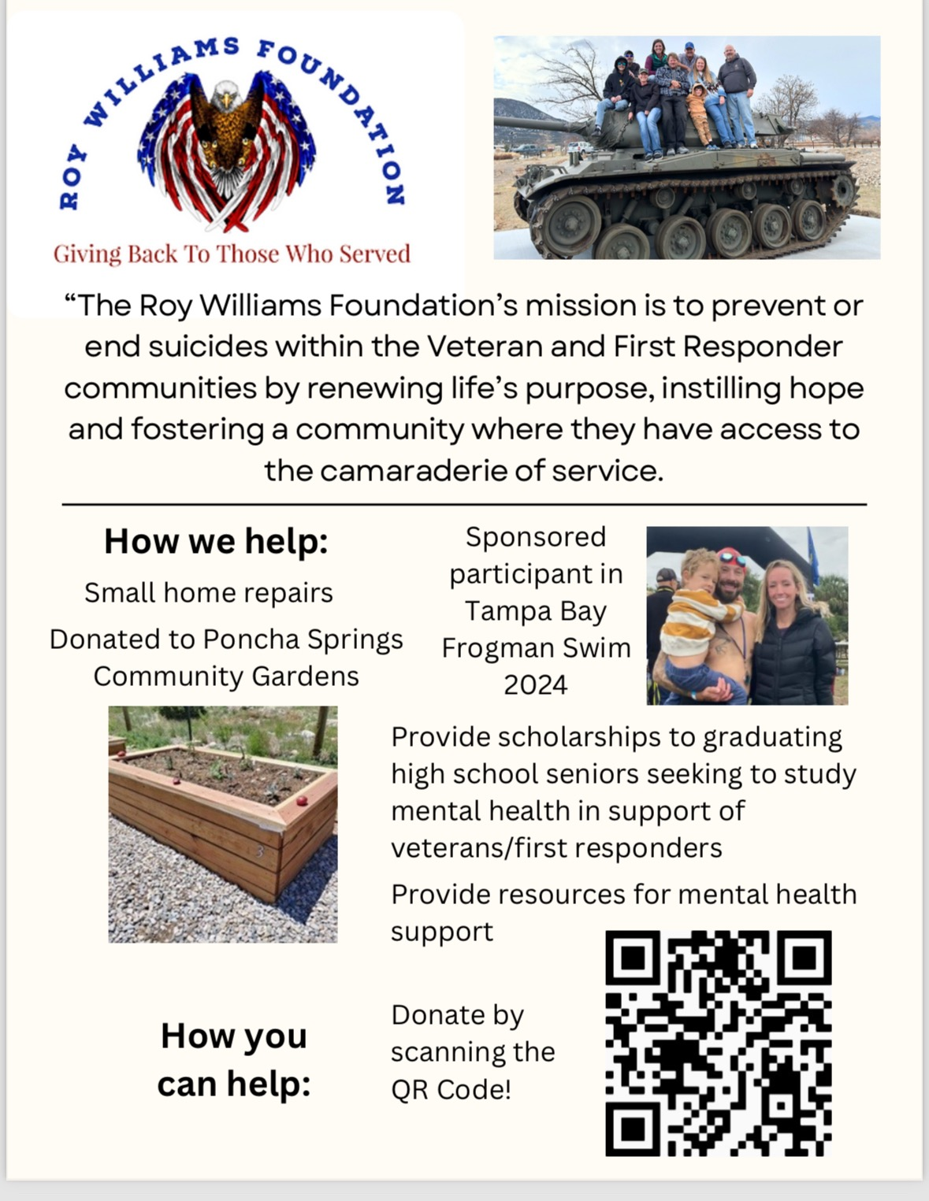
Roy Williams Foundation
Notes:
Mission of VA: To fulfill President Lincoln’s promise,
1. It was March 4, 1865, a time of great uneasiness. In just over one month, the war would end and the president would be assassinated.
“With malice toward none, with charity for all, with firmness in the right as God gives us to see the right, let us strive on to finish the work we are in, to bind up the nation’s wounds, to care for him who shall have borne the battle and for his widow, and his orphan, to do all which may achieve and cherish a just and lasting peace among ourselves and with all nations.”
“To care for him who shall have borne the battle, and for his widow, and his orphan” by serving and honoring the men and women who are America’s Veterans. (www.va.gov)
2. VA budget= $266 Bn in FY22. In 2022 there are approximately 20M Veterans which should translate to each Veteran getting the benefit of $13,000 per Veteran PER YEAR.
3. But only 9m Veterans of 20 M are in the VHA system – 45% taking advantage. NEED TO GET THE WORD OUT – MARKETING
4. The Veterans Health Administration is the largest integrated health care system in the United States providing care at 1,298 health care facilities to over 9 million Veterans. We have 3 major facilities in CO – Aurora, Co Spgs and Grand Junction. Chaffee is in CO East VAMC with Aurora and Co Spgs. The VA overall is the 2nd largest Federal Department behind the DoD. The VA employs 412, 892 people in the United States plus contractors.
5. @ 604 programs: VHA – @ 484 programs + VBA over 100 payment programs + NCA over 20 programs and 4 cemeteries in CO
6. Chaffee County has 20,074 residents and is home to 1,820 VA registered Veterans per the GDX report FY2021. 9% are Veterans.
7. Yes – Leisl Hammond, VSO, Salida
8. Yes – See Leisl Hammond, VSO, Salida
9. CO is 7% below average on using benefits / Veteran and Chaffee is 37% below average on using benefits / Veteran of CO counties. GET THE WORD OUT TO VETS!

Slide 7
Roy Williams Foundation Supporting the Mission
Suicide Prevention Training 509.95
Freedom Service Dogs of America 1500
Navy Seal Foundation Tampa Bay Frogman 1000
Scholarships (4 @ $1000 each) 4000
Families of Veterans 3500
Home Repairs 521.51
Assistance with Utility Bills 570.18
Counseling Services 255
Donation to Poncha Springs Com. Garden 500
Total
supporting
Chaffee
County
Veterans
and
First Responders
12,356.64

Slide 8
Roy Williams Foundation Questions????

Slide 9
Veterans Benefits - Chaffee County VSO and VA

Slide 10
Chaffee County Veterans Service Office
Leisl Hammond – Veterans Service Officer (VSO)
Disability/Pension packets
Discussion/Compilation/Completion with Veteran
Ongoing coordination with VA
Outreach
Additional support to Veterans as required
Jan Wilson - Transportation Coordinator
Transportation to all VA appointments in Salida and out of town. Drivers are Chaffee County volunteers, approved by VA, who drive two VA vehicles assigned to Chaffee County.

Slide 11
Requirements to Qualify for VA Benefits
Type of service: Veteran must have served 24 continuous months or the full period for which called to active duty unless Veteran was discharged early due to an injury, hardship, or served prior to 7SEP1980 (90 days on active duty).
Nature of discharge: “under conditions other than dishonorable”
Honorable
General Discharge – Under Honorable Conditions
Other Than Honorable Discharge
Bad Conduct Discharge
Dishonorable Discharge
Uncharacterized Discharge
*There are exceptions, work with your VSO

Slide 12
VHA - US’ largest Medical and Hospital system
How good is the VA?:
VA Health System Generally Delivers Higher-Quality Care Than Other Health Providers | RAND
“Consistent with previous studies, our analysis found that the VA health care system generally provides care that is higher in quality than what is offered elsewhere in communities across the nation,” said Rebecca Anhang Price, lead author of the study and senior policy researcher at RAND Corporation, a nonprofit research organization.
While the study found wide variation in the quality of care provided across the VA health system, the variation is smaller than what researchers observed among non-VA health providers.”
What is available?
Go to:
https://www.va.gov/health/topics/index.asp
E – Eldercare
P - Pharmacy

Slide 13
PACT ACT: 2022 $280 Billion Dollar Expansion
Largest expansion of care for veterans in VA history, the bill will provide $280 billion dollars in care to veterans over the next 10 years.
PACT ACT = Promise to Address Comprehensive Toxics (PACT) Act.
The PACT Act aims to provide care for veterans injured by exposure to toxins from Agent Orange in Vietnam (along with neighboring countries) to burn pits in the Middle East.
Veterans no longer have to prove their illness was caused by toxic exposures in the military in order to get VA coverage.
Expands and extends eligibility for VA health care for Veterans with toxic exposures and Veterans of the Vietnam, Gulf War, and post-9/11 eras
Adds more than 20 new presumptive conditions for burn pits and other toxic exposures
Adds more presumptive-exposure locations for Agent Orange and radiation
Requires VA to provide a toxic exposure screening to every Veteran enrolled in VA health care
Helps us improve research, staff education, and treatment related to toxic exposures
Filing a claim:
If you haven’t filed a claim yet for the presumptive condition, you can file a new claim online now.
You can also file by mail, in person, or with the help of a trained professional.

Slide 14
VA Benefits for Veterans and Dependents
Disability Compensation
Pension
Education benefits
Survivor benefits
Medical care & treatment
Life insurance
Vocational rehabilitation
Burial and memorial benefits

Slide 15
Four Major VA Monetary Benefit Programs
Veteran Disability Compensation
Veteran Pension
Survivor and Dependent Benefits
Educational Assistance (GI Bill)

Slide 16
1. VA Disability Compensation
VA disability compensation (pay) offers a monthly tax-free payment to Veterans who got sick or injured while serving in the military and to Veterans whose service made an existing condition worse. 38 U.S.C. – 1110, 1131

Slide 17
1. Disability – Types of Service Connection
Direct
Disability results from an injury or disease incurred in line of duty during active service.
Aggravated
Pre-existing condition was made worse by military service.
Presumptive
Disability presumed to have been caused by service based on location or circumstances of service, or by military service itself.
Secondary
Disability proximately due to, or the result of, a service-connected condition – the s/c condition directly caused the claimed disability.

Slide 18
1. VA Disability Adjudication of Claims Process
Claim received
Claim reviewed
Evidence gathered – VA has a “duty to assist.” VA may request evidence from the claimant, a medical professional, a government agency, etc.
Evidence reviewed
Decision prepared
Decision reviewed and approved
Notification prepared
Decision mailed

Slide 19
1. Disability Compensation Rating
Rating claims: Once service-connected, disabilities are assigned a disability rating from 0% to 100%. The criteria for rating a particular injury or condition are found in the VA Schedule for Rating Disabilities (Rating Schedule).
Legal Basis for Compensation: The Rating Schedule percentages “represent as far as can practicably be determined the average impairment in earning capacity resulting from such diseases and injuries and their residual conditions in civil occupations. 38 C.F.R. – 4.1

Slide 20
2. VA Disability Pension
Veterans Pension is a tax-free monetary benefit payable to low-income wartime Veterans.
Eligibility is premised on wartime service on active duty in the Armed Forces of the United States. Governed by Chapter 15 of the Title 38, U.S. Code. 38 C.F.R. – 3.271-3.277
VA Pension is a needs-based benefit. Net worth must not exceed $150,538 not to include your private home but does include additional land.

Slide 21
3. VA Survivor & Dependent Benefits
Veterans Survivors Pension: A tax-free monetary benefit payable to a low-income, un-remarried surviving spouse and/or unmarried children of a deceased Veteran with wartime service. A means-based benefit based on yearly family income.
Dependency and Indemnity Compensation (DIC): A tax-free monetary benefit generally payable to survivors of Servicemembers who died while on active duty, active duty for training, inactive duty training, or to survivors of Veterans who died from their service-connected disabilities.

Slide 22
4. VA Educational Benefits
VA administers several programs through which Veterans, servicemembers, and Veterans’ survivors/dependents can pursue programs of education at various levels.
Post 9/11 GI Bill (Ch.33) Effective 1AUG2009
Montgomery GI Bill – Active Duty & Reserve (Ch.30)
Survivors’ and Dependents’ Educational Assistance Program
Veterans Readiness and Employment (VR&E)

Slide 23
5. Burial Benefits
Veterans and spouses may be eligible for burial in a VA National Cemetery or State Cemetery. Civilian Cemetery reimbursement will mirror the burial at a National or State Cemetery.
Transportation Cost – mortuary to cemetery
A limited $ amount for plot reimbursement
Free Headstone or Marker
Additional $ based on circumstances surrounding death

Slide 24
How you can help Veterans
Encourage Veterans to apply for and use their benefits
Volunteer to drive Veterans to their VA medical appointments through the Chaffee County VSO office
Vote for candidates who support Veterans

Slide 25
Chaffee County VSO - Questions???
Leisl Hammond 719-239-4678
448 E. 1st Street Room 134 (Touber Building) Salida
vso@chaffeecounty.org
VSO Office Hours by Appointment
Monday - Saturday as needed based on Veterans’ availability
Additional Information: www.va.gov
Appeals Management Office

